Slide 1
Dijkstra’s shortest path algorithm
An algorithm for the shortest path from one node to all the other nodes

Slide 2
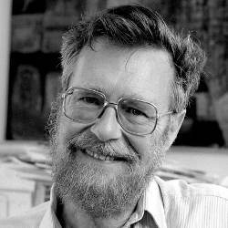
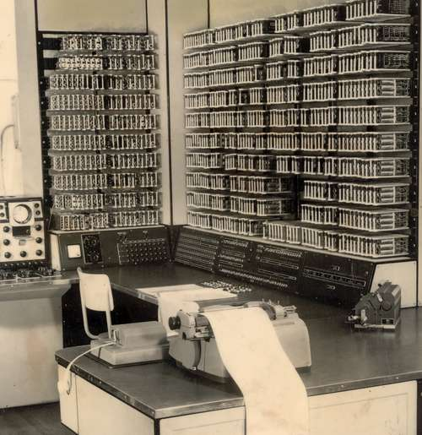
History
Inspired by some algorithms like Prim’s minimal spanning tree algorithm, Dijkstra’s was first used for many graphing purposes. It was implemented into computer systems like the then new ARMAC, where it was used as part of a system monitoring the status of 64 Dutch cities before being published in 1959.
It was soon useful for other people and in other fields with similar problems, for example establishing routes between connections in electronics and efficient material use in engineering.
Above: Edsger Dijkstra in 1972
Below: ARMAC in the Mathematical centre

Slide 3
Method
The shortest path algorithm examines the distances of connections between nodes on a graph. It starts with the shortest through to the longest around the starting node and repeats this process for the connected nodes in the same distance order, expanding a circular field out from the root as more nodes get included in the chains. It checks slightly longer paths for a situation where it might be much shorter later on, in an attempt to find a shorter route between the two points. This all results in table of all the possible routes from the start to ending nodes and their distances.
s
While this may initially appear to be done in a very brute force route, it does manage to observe all possibilities of routes, effectively proving it’s the shortest route to take by eliminating all other possibilities.

Slide 4
Steps _{(to success)}
Examples are not to scale
∞
∞
∞
E
6
D
B
4
∞
1
Before the shortest distances are calculated and assigned to a node, you need to give them temporary values that are replaced later. Keeping at extremes will prompt the system to check them. Assign the starting node the distance zero as it is relative to itself and infinity for the others.
Mark the initial starting node as current by storing it in the respective variable, working can be started from there and working through nodes marked as “unvisited” which are stored in that set.
Then calculate the tentative distances of the neighbouring nodes from the current node and compare them to find the closest and set that as the new current node. In sequences where a shorter route to a node is found the value can be replaced by the shorter one.
3
3
C
0
5
A
A
Variables
2:
Current= A
Unvisited= B,C,D,E
3:
Current= B
Unvisited=B,C,D,E
∞
6
∞
3
E
D
B
4
1
3
3
C
0
6→5
A
5
Results Table
Possible Routes | Distance | Total
A,C,E | 5+4 | 9
A,B,C,E | 3+3+4 | 10
A,C,D,E | 5+1+6 | 12
A,B,C,D,E | 3+3+1+6 | 13

Slide 5
Steps _{(continued)}
13→12 →9
E
6
7→6
Mark the new current node as visited and remove from the ‘Unvisited’ set so that it will never be checked again.
If a node has already been visited or if the tentative distances to the remaining nodes are still infinity which would imply that they aren't connected to any visited node we could already get to, then there are no nodes left to check then you can stop checking and the algorithm as a whole.
When there is no connection or route to the remaining unvisited nodes then the only option to complete the process is to set the nearest node to the root as the new current and return to step 3.
3
4
D
B
3
1
3
C
6→5
0
A
5
Variables
4:
Current= B
Unvisited= C,D,E
∞
∞
E
2
F
3
B
5
3
3
C
1
6
0
5
D
A
There can be situations where there are nodes that cannot be measured due to their isolation.

Slide 6
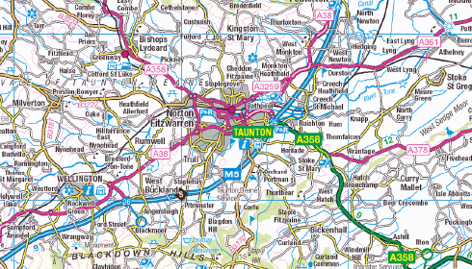
Impact
On Computers
On Infastructure
The algorithm is now implemented into many operating systems as it has a use as evaluating and improving optimisation, as well as in higher level situations such as on the internet where it can be used in social networking to see the likelihood of knowing someone from connections with others.
It is now useful as a way of calculating and comparing the routes and distances between points on a graph an obvious use would be with navigation, especially regarding roads(e.g. links) which are characteristically persistent and reliable for a journey so are able to be implemented in a graph as a digital map ~and can be used in assisting in a road’s planning and placement.
1
2
Here the algorithm can be used to evaluate if Laverne(L) is likely to know Tim(T) (each link is valued or distanced the same)
H
T
0
4 → 3
L
N
1
B
F
3→2
1+1+1=3

Slide 7
In Conclusion
Dijkstra’s shortest path algorithm was originally designed for use in computers like ARMAC with defence and city monitoring in mind but has expanded its uses due to the applications for finding the shortest routes being so broad.
It works by comparing the distances of nodes from each other and the starting point starting with the closest node to the root and gradually working out in order of tentative distances by getting the distances from the current and combining that with the distance traversed to get to the current node from the root. This will continue to create routes to the end until it is certain that the best one is found and all possibilities are exhausted or if the remaining nodes are unreachable and require to be measured from their own set.

